Slide 1


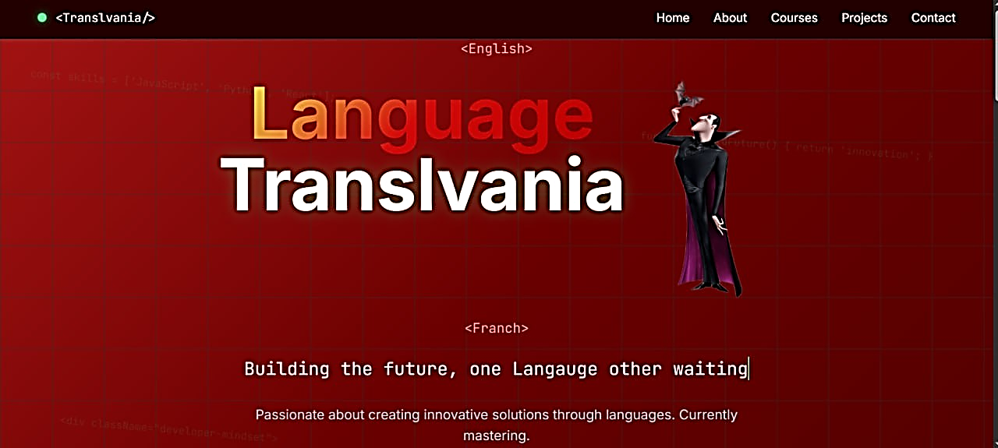
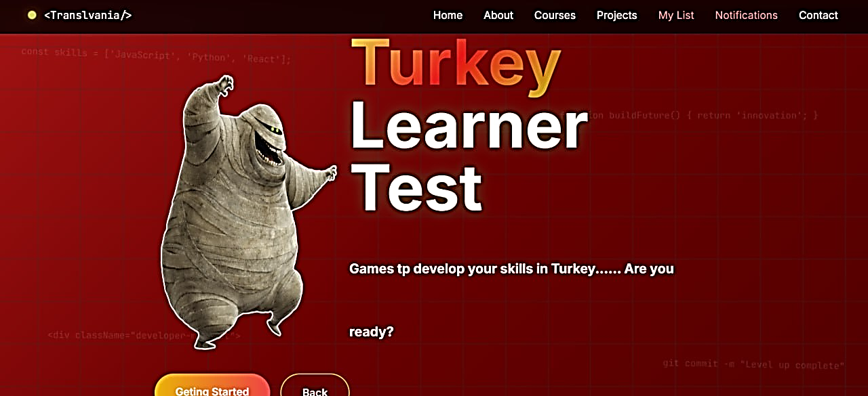
Syrian Private University
Department of Software Engineering and Intelligent Systems
LANGUAGE LEARNING SYSTEM
PREPARED BY:
AYAT MAHMOUD NOOR SHEIKHA
SUPERVISED BY:
DR. SHADI BLEIDI
2026-2027

Slide 2



CONTENT
01
Introduction
02
Importance & Objectives
03
Reference study
04
Actors & Functional requirements
05
Methodology & Gantt
06
Architecture
07
Use case high level

Slide 3

Introduction
This project aims to develop an interactive language-learning platform using digital games and educational activities to enhance learner motivation and improve the learning experience.
The platform provides placement tests, educational games, interactive stories, listening and challenges, as well as learner progress tracking and content management.
The system uses Laravel and the MVC architecture, following the Scrum methodology for iterative development and continuous improvement.

Slide 4





Enhancing Learning Motivation:
Using digital games to make language learning more enjoyable and engaging
Personalizing the Learning Experience: Helping learners identify their levels and choose activities suited to their abilities
Importance
Tracking Progress and Improving Performance: Enabling learners to monitor their results and language skill development
Providing an Interactive Learning Environment: Using games, interactive stories, and listening challenges to develop language skills practically

Slide 5
OBJECTIVES
OBJECTIVE 01
OBJECTIVE 03
Developing Language Skills Helping learners improve their language skills through games and interactive activities.
Tracking Learner Progress Recording results and monitoring performance to evaluate learning progress
OBJECTIVE 02
OBJECTIVE 04
Assessing Learner Levels Providing placement tests to guide learners toward activities suited to their abilities.
Managing Educational Content Providing administrators with tools to manage and update games, courses, and educational content.

Slide 6
Reference study
Platform / System | Strengths | Weaknesses
Duolingo | Gamified learning, AI personalization, rewards, and multi-platform support. | Limited voice interaction, shallow grammar coverage, and potential translation inaccuracies.
Memrise | Authentic pronunciation videos, smart repetition, and daily challenges. | Limited grammar coverage, weak advanced content, and minimal voice interaction.
freeCodeCamp | Free access, practical projects, structured learning paths, and a supportive community. | Focuses on programming rather than languages and may require external resources.
edX | High-quality academic content, accredited certificates, and diverse subjects. | Paid courses, limited interaction, and limited personalization.
Busuu | Personalized learning plans, strong grammar coverage, and native-speaker feedback. | Limited free content, paid features, and interaction dependent on user availability.
Proposed Project | Interactive language games, placement tests, progress tracking, interactive stories, listening challenges, and content management. | Requires development and testing to ensure content accuracy, usability, and learning effectiveness.

Slide 7



Actors
Learner:
Creates an account and logs in, selects a language to learn, takes placement tests, practices educational games, tracks results and progress, enrolls in courses, and reviews learned vocabulary.
Administrator:
Manages learner accounts and adds, edits, and deletes games, courses, languages, levels, and questions. Monitors learner performance and sends announcements and notifications.

Slide 8
FUNCTIONAL REQUIREMENT

Slide 9
MoSCoW | Scenario | Description | actor | Requirement | RQ_ID
Must | The system should allow the learner to sign up using their details | The learner creates a new account by entering their personal information such as email and username | Learner | Sign up | RQ_1
Must | The system should allow the learner to log in | The learner enters their credentials (email/username and password) to access the system | Learner | Log in | RQ_2
Should | The system should allow learners to manage their accounts, including updating personal information,and adjusting preferences for security. | Learners can update personal details, and adjust preferences to maintain secure and flexible accounts. | Learner | Managing Accounts | RQ_3
Must | The system should allow the learner to log out | The learner can securely exit their account | Learner | Logout | RQ_4
Should | The system should show available languages | The learner can view a list of supported languages | Learner | Show available languages | RQ_5
Should | The system should show available games by language | The learner can browse games categorized by language (English, Arabic, Turkish) | Learner | Show available games | RQ_6
Must | The system should determine the learner’s level in the language | The learner completes a placement test to identify their level | Learner | Determine level | RQ_7
Must | The system should allow the learner to play English Game 1 | The learner can access and play the first English game | Learner | Game 1 English | RQ_8
Should | The system should allow the learner to play English Game 2 | The learner can access and play the second English game | Learner | Game 2 English | RQ_9
Must | The system should allow the learner to play Arabic Game 1 | The learner can access and play the first Arabic game | Learner | Game 1 Arabic | RQ_10
Should | The system should allow the learner to play Arabic Game 2 | The learner can access and play the second Arabic game | Learner | Game 2 Arabic | RQ_11
Must | The system should allow the learner to play Turkish Game 1 | The learner can access and play the first Turkish game | Learner | Game 1 Turkish | RQ_12
Should | The system should allow the learner to play Turkish Game 2 | The learner can access and play the second Turkish game | Learner | Game 2 Turkish | RQ_13
Must | The system should show current results for all games | The learner can view their performance and scores across all played games | Learner | Show current results | RQ_14
Should | The system should allow the learner to update their level | The learner can retake the placement test to update their level | Learner | Update level | RQ_15
Could | The system should allow the learner to contact admin | The learner can send a message to the admin | Learner | Contact admin | RQ_16
Could | The system should allow the learner to rate | The learner can submit a rating | Learner | Rate | RQ_17
Could | The system should allow the learner to view other ratings | The learner can browse ratings from other learners | Learner | View ratings | RQ_18
Could | The system should allow the learner to like/dislike a rating | The learner can react to ratings | Learner | Like/Dislike rating | RQ_19
Could | The system should allow filtering ratings | The learner can filter ratings by likes or date | Learner | Filter ratings | RQ_20
Should | The system should allow the learner to re-determine level | The learner can retake a new level test | Learner | Redetermine level | RQ_21
Must | The system should determine Arabic level | The learner can take an Arabic placement test | Learner | Determine Arabic level | RQ_22
Must | The system should allow the learner to play Arabic Game 1 | The learner can play Arabic game 1 | Learner | Arabic Game 1 | RQ_23
Should | The system should allow the learner to play Arabic Game 2 | The learner can play Arabic game 2 | Learner | Arabic Game 2 | RQ_24
Could | The system should allow the learner to play Arabic Game 3 | The learner can play Arabic game 3 | Learner | Arabic Game 3 | RQ_25
Should | The system should show levels | The learner can view all available levels | Learner | Show levels | RQ_26
Must | The system should allow the learner to take courses | The learner can enroll in courses | Learner | Take courses | RQ_27
Must | The system should allow the admin to log in | Admin can access the system | Admin | Admin login | RQ_28
Must | The system should show admin dashboard | Admin can view system statistics and controls | Admin | Show dashboard | RQ_29
Should | The system should allow admin to reply to messages | Admin can respond to learner messages | Admin | Reply to message | RQ_30
Must | The system should allow learners to reset their passwords | The learner can reset a forgotten password through a secure process | Learner | Reset password | RQ_31
Must | The system should save game progress | The system saves the learner's progress and scores after completing a game | Learner | Save game progress | RQ_32
Should | The system should display learner progress | The learner can view progress and achievements for each language | Learner | View progress | RQ_33
Should | The system should recommend games based on learner level | The system suggests suitable games according to the learner's language level | Learner | Recommend games | RQ_34
Must | The system should allow learners to view course details | The learner can view course descriptions, content, and requirements before enrolling | Learner | View course details | RQ_35
Should | The system should track course completion | The system records completed lessons and the learner's progress in each course | Learner | Track course progress | RQ_36
Must | The system should allow the admin to manage languages | The admin can add, update, and remove supported languages | Admin | Manage languages | RQ_37
Must | The system should allow the admin to manage games | The admin can add, update, and remove games and their educational content | Admin | Manage games | RQ_38
Should | The system should allow the admin to manage courses | The admin can create, update, and remove courses and their content | Admin | Manage courses | RQ_39

Slide 10
MoSCoW | Scenario | Description | actor | Requirement | RQ_ID
Should | The system should allow the admin to manage learner accounts | The admin can view learner accounts and activate, deactivate, or manage them according to assigned permissions | Admin | Manage learner accounts | RQ_40
Should | The system should allow learners to review their previous answers | The learner can review correct and incorrect answers after completing a game | Learner | Review Answers | RQ_41
Should | The system should display correct answers after a game ends | The learner can view the correct answers and compare them with their own answers | Learner | Show Correct Answers | RQ_42
Should | The system should allow learners to view their test history | The learner can view previous placement test results | Learner | View Test History | RQ_43
Should | The system should allow learners to change their preferred language | The learner can select the preferred language for the system interface | Learner | Change Interface Language | RQ_44
Could | The system should send notifications to learners | The learner can receive notifications about new courses and important updates | Learner | Receive Notifications | RQ_45
Should | The system should allow the admin to view performance reports | The admin can view reports about learner performance and game results | Admin | View Performance Reports | RQ_46
Should | The system should allow the admin to manage language levels | The admin can add, update, and delete language levels | Admin | Manage Language Levels | RQ_47
Should | The system should allow the admin to manage test questions | The admin can add, update, and delete placement test questions | Admin | Manage Test Questions | RQ_48
Could | The system should allow the admin to send announcements to learners | The admin can publish announcements about updates and educational activities | Admin | Manage Announcements | RQ_49
Should | The system should record the learner's last login date | The admin can view each learner's last login date for monitoring purposes | Admin | Track Last Login | RQ_50
Should | The system should allow the admin to update their profile image | The admin can upload a new profile image or change the existing one | Admin | Update Admin Image | RQ_51
Should | The system should allow users to view their profiles | The user can view their personal profile information | Learner | View User Profile | RQ_52
Should | The system should allow learners to change their names | The learner can update their name in their account | Learner | Change Name | RQ_53
Should | The system should display saved learner levels, if available | The learner can view previously determined language levels | Learner | View Existing Levels | RQ_54
Should | The system should allow learners to retake a placement test | The learner can retake the test to determine their level again | Learner | Retake Test | RQ_55
Could | The system should notify learners when a new game is added | The learner receives a notification when a new game is added to a language | Learner | New Game Notification | RQ_56
Should | The system should allow learners to challenge AI in English | The learner can participate in an interactive challenge against AI in English | Learner | Challenge AI in English | RQ_57
Could | The system should allow learners to interact with stories | The learner can interact with educational stories through available choices or activities | Learner | Interactive Stories | RQ_58
Should | The system should allow learners to change their profile images | The learner can upload a new image or change the existing profile image | Learner | Change User Image | RQ_59
Should | The system should allow learners to participate in listening challenges | The learner can complete challenges based on listening to audio clips and answering related questions | Learner | Listening Challenges | RQ_60
Should | The system should allow learners to save favorite games | The learner can add games to a favorites list and access them later | Learner | Manage Favorite Games | RQ_61
Should | The system should display learner rankings based on scores | The learner can view a leaderboard based on game results | Learner | View Learner Rankings | RQ_62
Could | The system should allow learners to change game difficulty | The learner can select a suitable difficulty level from the available options | Learner | Change Game Difficulty | RQ_63
Should | The system should allow learners to track their achievements | The learner can view badges and achievements earned through educational activities | Learner | View Achievements | RQ_64
Should | The system should allow learners to review learned vocabulary | The learner can view a list of new words learned through games and lessons | Learner | Review Learned Vocabulary | RQ_65

Slide 11
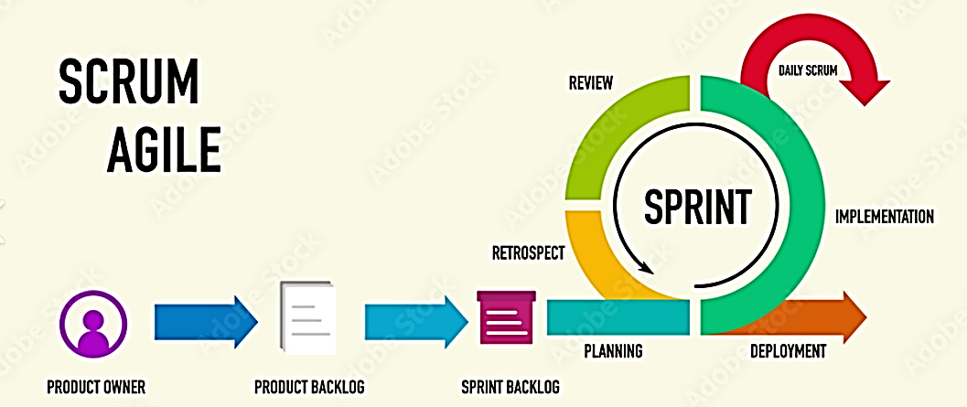
Methodology
Sprint 1
Requirements Analysis, Literature Review, and Project Scheduling
Sprint 2
Account and Profile Management
Sprint 3
Placement Tests and Assessment Management
Sprint 4
Educational Game Development and Progress Tracking
Sprint 5
Courses and Interactive Learning
Sprint 6
Administration Dashboard Development and System Quality Assurance

Slide 12
GANTT CHART

Slide 13
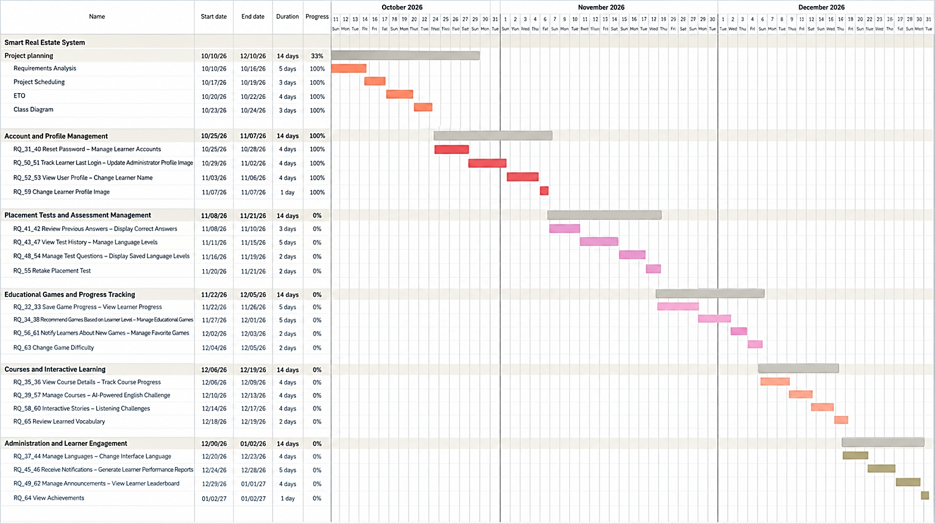

Slide 14
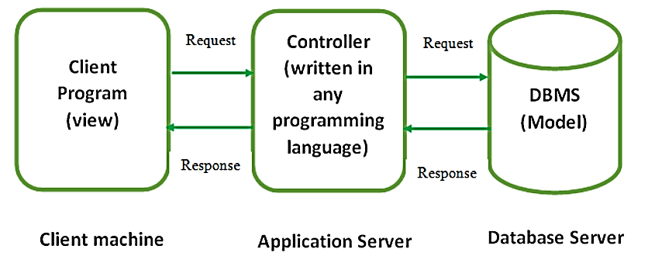
Architecture

Slide 15
USE CASE

Slide 16
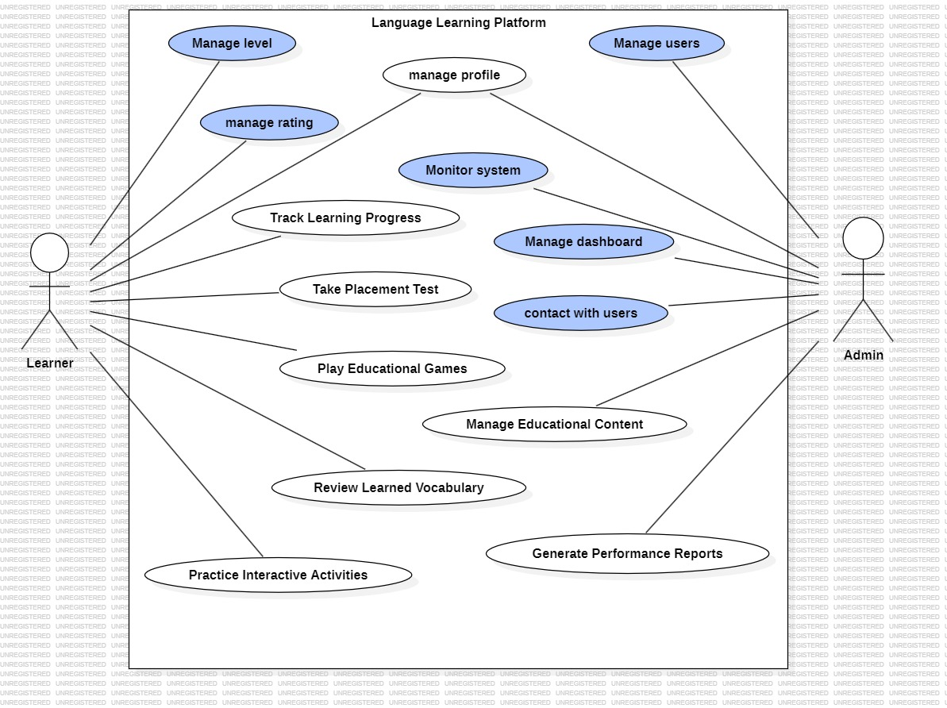

Slide 17






Tools used

Slide 18
THANK YOU

